Slide 1
E-Commerce Reviews and
Rating Project
Based on Amazon and Flipkart data

Slide 2
The Question:
■Given that reviews are highly subjective, and star ratings can be influenced by various aspects of business performance, can we use machine learning to standardize the interpretation of reviews?

Slide 3
Hypothesis:
Users fall into discrete behavior groups
■Can we use ML to cluster users into distinct groups based on star rating behavior?
–Perhaps there are users who only rate when extremely happy or upset (rate at extremes), users who rate moderately, etc.
■Approach: Use unsupervised machine learning to identify groups
–K-Means Clustering
■Can also be used to feed subsets of data to text-based analyses performed by team

Slide 4
Features
■Star Rating Distribution; Percentages of 1-star reviews, 2-star reviews, etc.
■Review Counts
■Rating Distribution Statistics per User: Mean, Median, Variance, etc.

Slide 5
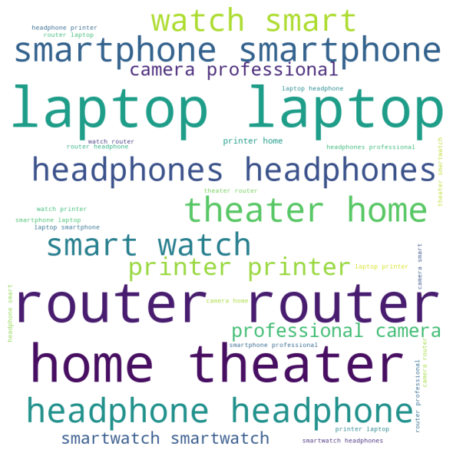

Slide 6

Review wordcloud

Slide 7
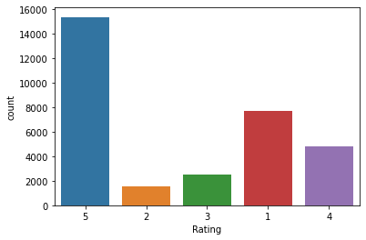

Slide 8
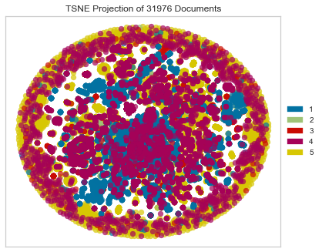

Slide 9
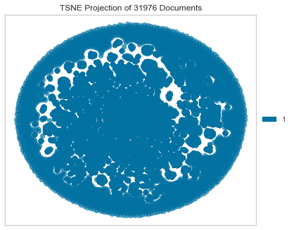

Slide 10
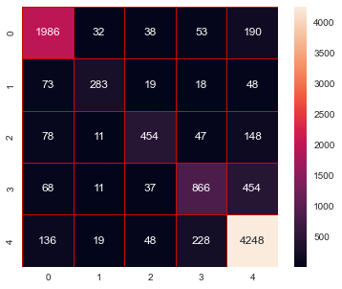
*******************RESULTS*******************
The accuracy score of train is : 91.98498860742528
The accuracy score test is : 81.69498592723862
The cross validation score is : 80.19032636873241
Confusion Matrix:
[[1986 32 38 53 190]
[ 73 283 19 18 48]
[ 78 11 454 47 148]
[ 68 11 37 866 454]
[ 136 19 48 228 4248]]
Classification precision recall f1-score support
1 0.85 0.86 0.86 2299
2 0.79 0.64 0.71 441
3 0.76 0.62 0.68 738
4 0.71 0.60 0.65 1436
5 0.83 0.91 0.87 4679
accuracy 0.82 9593
macro avg 0.79 0.73 0.75 9593
weighted avg 0.81 0.82 0.81 9593
***********************************************
DecisionTreeClassifier()

Slide 11
Hyper parameter tuning
In [81]:
param_grid = [
{"n_estimators": range(20, 100, 2),
"max_depth": [1, 2, 4, 6, 9, 12],
"min_samples_split": [2, 6, 8],
"min_samples_leaf": [1, 2, 3],
}
]
​
​
ran_clf = RandomForestClassifier(random_state = 89)
rf_grid = GridSearchCV(ran_clf,param_grid,cv = 2,)
rf_grid.fit(X_train,y_train)
params = rf_grid.best_params_
print("Best Params ",params)
Best Params {'max_depth': 12, 'min_samples_leaf': 1, 'min_samples_split': 6, 'n_estimators': 22}

Slide 12
rand_clfr = RandomForestClassifier(n_estimators = 26,min_samples_split=2,min_samples_leaf=1,max_features='auto',max_depth=12,
criterion='entropy',bootstrap = True)
rand_clfr.fit(X_train,y_train)
rf_pred = rand_clfr.predict(X_test)
print('Final Random Forest Classifier Model')
print('Accuracy Score :', accuracy_score(y_test, rf_pred))
print('\n')
print('Confusion matrix of Random Forest Classifier :',confusion_matrix(y_test, rf_pred))
print('\n')
print('Classification Report of Random Forest Classifier: ',classification_report(y_test, rf_pred))
Final Random Forest Classifier Model
Accuracy Score : 0.5218388408214323
Confusion matrix of Random Forest Classifier : [[ 334 0 0 0 1965]
[ 12 0 0 0 429]
[ 14 0 0 0 724]
[ 1 0 0 0 1435]
[ 7 0 0 0 4672]]
Classification Report of Random Forest Classifier: precision recall f1-score support
1 0.91 0.15 0.25 2299
2 0.00 0.00 0.00 441
3 0.00 0.00 0.00 738
4 0.00 0.00 0.00 1436
5 0.51 1.00 0.67 4679
accuracy 0.52 9593
macro avg 0.28 0.23 0.18 9593
weighted avg 0.46 0.52 0.39 9593

Slide 13
Out[103] 9593 rows × 2 columns
 | original | predicted
0 | 2 | 5
1 | 5 | 5
2 | 3 | 5
3 | 3 | 5
4 | 1 | 1
... | ... | ...
9588 | 1 | 5
9589 | 1 | 1
9590 | 5 | 5
9591 | 5 | 5
9592 | 4 | 5
Saving the best Model
In [101]:
import pickle
filename = 'Rating_Prediction.pkl'
pickle.dump(rf_pred,open(filename,'wb'))

